Slide 1
General License Course Chapter 4.4
Reactance

Slide 2
Reactance
Definition: The resistance to the flow of alternating current (AC) caused by
capacitance or inductance is called reactance
and is denoted by the symbol X.
It is measured in ohms, like resistance.

Slide 3
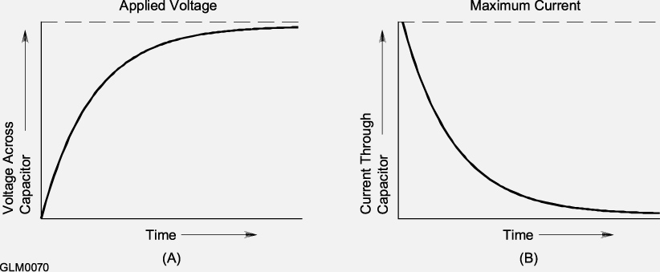
Capacitive Reactance
The opposition to alternating current flow from the stored electrostatic energy in a capacitor is called capacitive reactance (X_{C})
As the frequency of the applied signal increases,
X_{C} decreases and vice versa
Xc = 1÷[2 π f C]

Slide 4
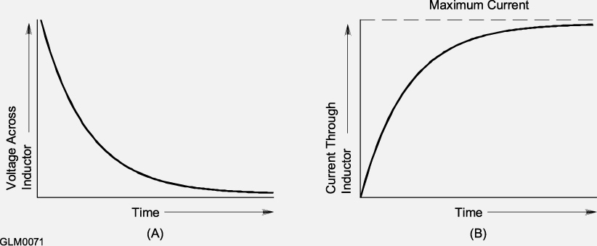
Inductive Reactance
The opposition to alternating current flow from the stored electromagnetic energy in a inductor (X_{L})
As the frequency of the applied signal increases,
X_{L} increases and visa versa
XL = 2 π f L

Slide 5
Parasitic Reactance
An unwanted characteristic resulting from the components physical construction
wire-wound resistor on a ceramic form
Inter-lead capacitance/inductance
Placing a wire-wound resistor in an RF circuit can make circuit performance unpredictable (fine for DC or low frequency)
RF circuits normally use carbon composition, carbon film, or metal oxide resistors which have very low inductance

Slide 6
Take Quiz 1

Slide 7
G5A02 What is reactance?
A. Opposition to the flow of direct current caused by resistance
B. Opposition to the flow of alternating current caused by capacitance or inductance
C. Reinforcement of the flow of direct current caused by resistance
D. Reinforcement of the flow of alternating current caused by capacitance or inductance

Slide 8
G5A02 What is reactance?
A. Opposition to the flow of direct current caused by resistance
B. Opposition to the flow of alternating current caused by capacitance or inductance
C. Reinforcement of the flow of direct current caused by resistance
D. Reinforcement of the flow of alternating current caused by capacitance or inductance

Slide 9
G5A03 - Which of the following is opposition to the flow of alternating current in an inductor?
A. Conductance
B. Reluctance
C. Admittance
D. Reactance

Slide 10
G5A03 - Which of the following is opposition to the flow of alternating current in an inductor?
A. Conductance
B. Reluctance
C. Admittance
D. Reactance

Slide 11
G5A04 - Which of the following is opposition to the flow of alternating current in a capacitor?
A. Conductance
B. Reluctance
C. Reactance
D. Admittance

Slide 12
G5A04 - Which of the following is opposition to the flow of alternating current in a capacitor?
A. Conductance
B. Reluctance
C. Reactance
D. Admittance

Slide 13
G5A05 - How does an inductor react to AC?
A. As the frequency of the applied AC increases, the reactance decreases
B. As the amplitude of the applied AC increases, the reactance increases
C. As the amplitude of the applied AC increases, the reactance decreases
D. As the frequency of the applied AC increases, the reactance increases

Slide 14
G5A05 - How does an inductor react to AC?
A. As the frequency of the applied AC increases, the reactance decreases
B. As the amplitude of the applied AC increases, the reactance increases
C. As the amplitude of the applied AC increases, the reactance decreases
D. As the frequency of the applied AC increases, the reactance increases

Slide 15
G5A06 - How does a capacitor react to AC?
A. As the frequency of the applied AC increases, the reactance decreases
B. As the frequency of the applied AC increases, the reactance increases
C. As the amplitude of the applied AC increases, the reactance increases
D. As the amplitude of the applied AC increases, the reactance decreases

Slide 16
G5A06 - How does a capacitor react to AC?
A. As the frequency of the applied AC increases, the reactance decreases
B. As the frequency of the applied AC increases, the reactance increases
C. As the amplitude of the applied AC increases, the reactance increases
D. As the amplitude of the applied AC increases, the reactance decreases

Slide 17
G5A09 - What unit is used to measure reactance?
A. Farad
B. Ohm
C. Ampere
D. Siemens

Slide 18
G5A09 - What unit is used to measure reactance?
A. Farad
B. Ohm
C. Ampere
D. Siemens

Slide 19
G6A06 - Why should wire-wound resistors not be used in RF circuits?
A. The resistor's tolerance value would not be adequate
B. The resistor's inductance could make circuit performance unpredictable
C. The resistor could overheat
D. The resistor's internal capacitance would detune the circuit

Slide 20
G6A06 - Why should wire-wound resistors not be used in RF circuits?
A. The resistor's tolerance value would not be adequate
B. The resistor's inductance could make circuit performance unpredictable
C. The resistor could overheat
D. The resistor's internal capacitance would detune the circuit

Slide 21
General License Course Chapter 4.4
Impedance and Resonance

Slide 22
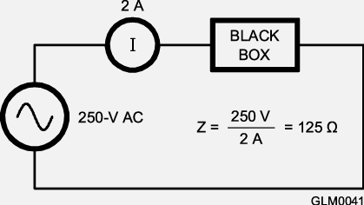
Impedance
Impedance - opposition to current flow in an ac circuit
Denoted by “Z” and measured in ohms (Ω)
Equal to voltage divided by current: Z = E/I (aka the ratio of voltage to current)
Includes the effects of R, X_{L} and X_{C}
The Inverse of impedance is admittance

Slide 23
Impedance Matching
Maximum power transfer occurs when the source and load impedances are equal
Most Amateur radio transmitting equipment is designed to have a 50 Ω output impedance
Most antennas are designed to have a feed point impedance of 50 Ω but rarely present that impedance over their entire frequency range
An impedance-matching circuit changes that variable impedance to the desired value

Slide 24
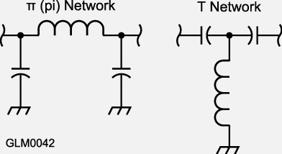
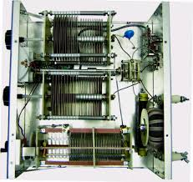
Impedance Matching
Method 1 - Many impedance matching circuits are LC networks employing inductors and capacitors (a Pi Network, for instance)
(most antenna “tuners”)

Slide 25
Impedance Matching
Method 2 - Special RF impedance-matching transformers are often used to equalize impedances between the source and load to maximize the transfer of power to the load
Method 3 - Special lengths of transmission line can also be used to match impedances
Three methods - all correct...

Slide 26
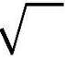
More on Transformers
Using a transformer to match impedances: The turn ratio between the primary and secondary is the square root of the ratio between the two impedances to be matched.
Example: The turns ratio of a transformer used to match an antenna’s 600-ohm feed point impedance to a 50-ohm coaxial cable is 3.5 to 1. (not 1 to 3.5)
NP
ZP
ZS
NP = turns on the primary
NS = turns on the secondary
=
ZP = primary impedance
ZS = secondary impedance
NS
=
600
=
=
3.46
12
50
(Round to 3.5)
25

Slide 27
Reactance
REVIEW: The resistance to the flow of alternating current (AC) caused by
capacitance or inductance is called reactance
and is denoted by the symbol X.
It is measured in ohms, like resistance.

Slide 28
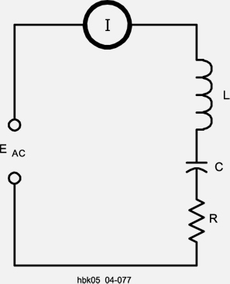
Resonance
Resonance in a circuit or antenna occurs when capacitive and inductive reactance are equal
In a resonant series circuit the reactances of the L and C cancel each other, forming a short circuit, leaving only the resistance, R, as the circuit’s impedance
Resonance is used in filters or tuned circuits to pass or reject specific frequencies
X_{L}=X_{C}
Series – Short Circuit
Parallel – Open Circuit

Slide 29
Self-Resonance
Occurs when a single components reactance equals the value of its parasitic reactance of the opposite type
Above its self-resonant frequency, a components reactance switches type, making an inductor capacitive (and vice versa).

Slide 30
Take Quiz 2

Slide 31
G5A01 - What happens when inductive and capacitive reactance are equal in a series LC circuit?
A. Resonance causes impedance to be very high
B. Impedance is equal to the geometric mean of the inductance and capacitance
C. Resonance causes impedance to be very low
D. Impedance is equal to the arithmetic mean of the inductance and capacitance

Slide 32
G5A01 - What happens when inductive and capacitive reactance are equal in a series LC circuit?
A. Resonance causes impedance to be very high
B. Impedance is equal to the geometric mean of the inductance and capacitance
C. Resonance causes impedance to be very low
D. Impedance is equal to the arithmetic mean of the inductance and capacitance

Slide 33
G5A07 - What is the term for the inverse of impedance?
A. Conductance
B. Susceptance
C. Reluctance
D. Admittance

Slide 34
G5A07 - What is the term for the inverse of impedance?
A. Conductance
B. Susceptance
C. Reluctance
D. Admittance

Slide 35
G5A08 What is impedance?
A. The ratio of current to voltage
B. The product of current and voltage
C. The ratio of voltage to current
D. The product of current and reactance

Slide 36
G5A08 What is impedance?
A. The ratio of current to voltage
B. The product of current and voltage
C. The ratio of voltage to current
D. The product of current and reactance

Slide 37
G5A10 - Which of the following devices can be used for impedance matching at radio frequencies?
A. A transformer
B. A Pi-network
C. A length of transmission line
D. All these choices are correct

Slide 38
G5A10 - Which of the following devices can be used for impedance matching at radio frequencies?
A. A transformer
B. A Pi-network
C. A length of transmission line
D. All these choices are correct

Slide 39
G5A11 - What letter is used to represent reactance?
A. Z
B. X
C. B
D. Y

Slide 40
G5A11 - What letter is used to represent reactance?
A. Z
B. X
C. B
D. Y

Slide 41
G5A12 - What occurs in an LC circuit at resonance?
A. Current and voltage are equal
B. Resistance is cancelled
C. The circuit radiates all its energy in the form of radio waves
D. Inductive reactance and capacitive reactance cancel

Slide 42
G5A12 - What occurs in an LC circuit at resonance?
A. Current and voltage are equal
B. Resistance is cancelled
C. The circuit radiates all its energy in the form of radio waves
D. Inductive reactance and capacitive reactance cancel

Slide 43
G5C07 - What transformer turns ratio matches an antenna's 600-ohm feed point impedance to a 50-ohm coaxial cable?
A. 3.5 to 1
B. 12 to 1
C. 24 to 1
D. 144 to 1

Slide 44
G5C07 - What transformer turns ratio matches an antenna's 600-ohm feed point impedance to a 50-ohm coaxial cable?
A. 3.5 to 1
B. 12 to 1
C. 24 to 1
D. 144 to 1

Slide 45
G6A11 - What happens when an inductor is operated above its self-resonant frequency?
A. Its reactance increases
B. Harmonics are generated
C. It becomes capacitive
D. Catastrophic failure is likely

Slide 46
G6A11 - What happens when an inductor is operated above its self-resonant frequency?
A. Its reactance increases
B. Harmonics are generated
C. It becomes capacitive
D. Catastrophic failure is likely

Slide 47
G7C03 - What is one reason to use an impedance matching transformer at a transmitter output?
A. To minimize transmitter power output
B. To present the desired impedance to the transmitter and feed line
C. To reduce power supply ripple
D. To minimize radiation resistance

Slide 48
G7C03 - What is one reason to use an impedance matching transformer at a transmitter output?
A. To minimize transmitter power output
B. To present the desired impedance to the transmitter and feed line
C. To reduce power supply ripple
D. To minimize radiation resistance

Slide 49
General License Course Chapter 8.1
The Ionosphere

Slide 50
The Ionosphere
Ionosphere – region beginning about 30 miles above the Earth and extending to about 300 miles
The air is thin enough that ultraviolet (UV) radiation from the sun can break the molecules of gas into individual atoms and then knock electrons away from them (the gas is ionized by the loss of an electron)
That layer of charged ions and free electrons refract electromagnetic waves back toward Earth

Slide 51
Ionospheric Regions
The main regions of the ionosphere are the D, E, F layers
D Layer: 30 – 60 miles in altitude (closest)
Only present when illuminated by the Sun – recombines quickly
Disappears at night when no UV rays are present
E Layer: 60 – 70 miles in altitude
Acts similarly to the D layer but recombines more slowly
Disappears -later- at night

Slide 52
Ionospheric Regions
F Layer: 100 – 300 miles above Earth
During the day it breaks into F1 and F2 layers
At night it combines into a single F layer - the ions and electrons don't recombine easily because the gas atoms are so spread out
The F1 and F2 layers vary with the local time, season, latitude and solar activity
The stronger the Sun’s illumination, the higher the F2 layer will be (maximum height occurs when the Sun is overhead)

Slide 53
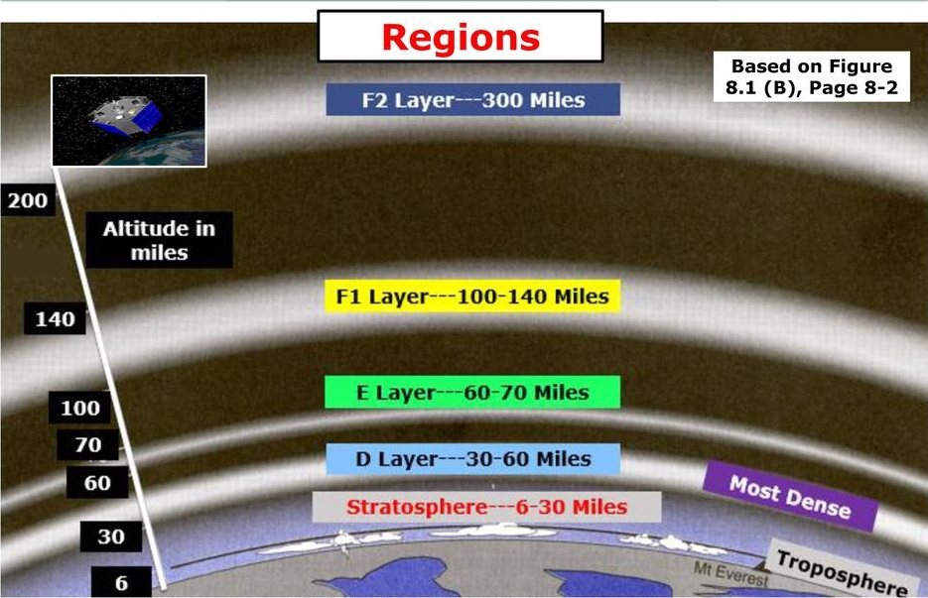

Slide 54
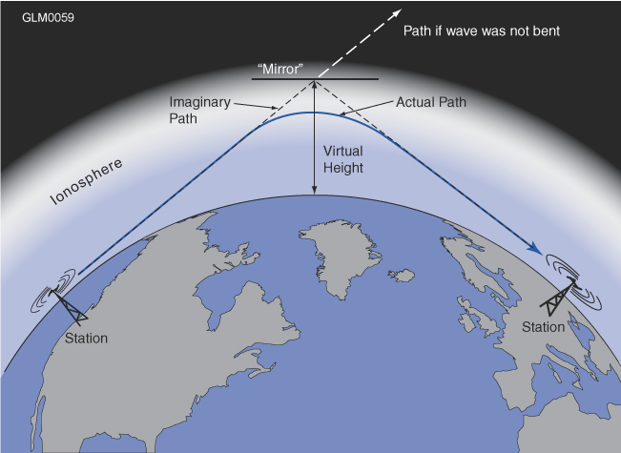
Reflection & Absorption
The ability of the ionosphere to refract radio waves depends on how strongly the ionoshere is ionized and the frequency used
The stronger the ionization, the greater the “bending”
The higher the frequency of the wave, the less it is bent (VHF & UHF are often hardly bent)

Slide 55
Reflection & Absorption
Critical Angle – the highest angle at which the radio wave will be refracted back to Earth (see next page)
Absorption increases in the daytime when the UV is more intense
Below 10 MHz signals can be completely absorbed by the D layer during the daylight hours (40, 60, 80, 160 meters) leaving only ground wave signals. The D layer is the most absorbent (lossy) layer
Lower HF frequencies typically experience high levels of atmospheric noise/static during summer months

Slide 56
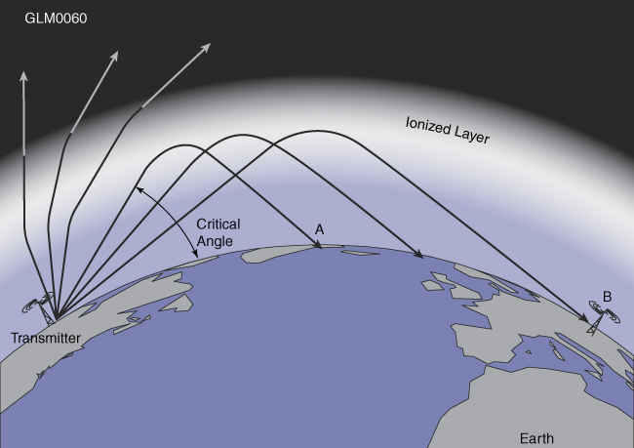
Sky-wave Propagation
Note that lower elevation angle signals travel farther on one “hop”

Slide 57
Sky-wave Propagation
Hop – one reflection from the ionosphere
Sky-wave (Skip) – propagation by ionospheric refraction. The higher the reflecting region, the longer the hop
F2 layer hops can be up to 2500 miles (highest layer, longest hops), E layer hops can be up to 1200 miles
MUF (Maximum Usable Frequency) – highest frequency at which sky-wave is available between two points. Also known as the Critical Frequency (the highest frequency which is refracted back to earth)
LUF (Lowest Usable Frequency) – frequency below which there is too much absorption for communication
Signals above the LUF but below the MUF will be bent back to earth by the ionosphere

Slide 58
Long Path & Short Path
Long path – signals that travel the long way around the world from point to point (180 deg from short path) – point directional antennas accordingly
Short path – most HF contacts are made via short path or the most direct route
Round-the-world propagation – occasionally you can hear your own signal coming all the way around the world (1/7 second delay echo)
A slightly-delayed echo may be heard if a sky-wave signal arrives from both short and long path directions

Slide 59
Long Path AND Short Path - Echo
C:\Users\ai2n\Videos\General Course - Videos\er4dx 10m multipath echo - 12_09 utc 4_12_2013.wmv
ER4DX (Moldova) on 10 meters

Slide 60
Take Quiz 3

Slide 61
G2D06 - How is a directional antenna pointed when making a "long-path" contact with another station?
A. Toward the rising sun
B. Along the gray line
C. 180 degrees from the station's short-path heading
D. Toward the north

Slide 62
G2D06 - How is a directional antenna pointed when making a "long-path" contact with another station?
A. Toward the rising sun
B. Along the gray line
C. 180 degrees from the station's short-path heading
D. Toward the north

Slide 63
G3B01 - What is a characteristic of skywave signals arriving at your location by both short-path and long-path propagation?
A. Periodic fading approximately every 10 seconds
B. Signal strength increased by 3 dB
C. The signal might be cancelled causing severe attenuation
D. A slightly delayed echo might be heard

Slide 64
G3B01 - What is a characteristic of skywave signals arriving at your location by both short-path and long-path propagation?
A. Periodic fading approximately every 10 seconds
B. Signal strength increased by 3 dB
C. The signal might be cancelled causing severe attenuation
D. A slightly delayed echo might be heard

Slide 65
G3B09 - What is the approximate maximum distance along the Earth's surface normally covered in one hop using the F2 region?
A. 180 miles
B. 1,200 miles
C. 2,500 miles
D. 12,000 miles

Slide 66
G3B09 - What is the approximate maximum distance along the Earth's surface normally covered in one hop using the F2 region?
A. 180 miles
B. 1,200 miles
C. 2,500 miles
D. 12,000 miles

Slide 67
G3B10 - What is the approximate maximum distance along the Earth's surface normally covered in one hop using the E region?
A. 180 miles
B. 1,200 miles
C. 2,500 miles
D. 12,000 miles

Slide 68
G3B10 - What is the approximate maximum distance along the Earth's surface normally covered in one hop using the E region?
A. 180 miles
B. 1,200 miles
C. 2,500 miles
D. 12,000 miles

Slide 69
G3C01 - Which ionospheric region is closest to the surface of Earth?
A. The D region
B. The E region
C. The F1 region
D. The F2 region

Slide 70
G3C01 - Which ionospheric region is closest to the surface of Earth?
A. The D region
B. The E region
C. The F1 region
D. The F2 region

Slide 71
G3C02 - What is meant by the term "critical frequency" at a given incidence angle?
A. The highest frequency which is refracted back to Earth
B. The lowest frequency which is refracted back to Earth
C. The frequency at which the signal-to-noise ratio approaches unity
D. The frequency at which the signal-to-noise ratio is 6 dB

Slide 72
G3C02 - What is meant by the term "critical frequency" at a given incidence angle?
A. The highest frequency which is refracted back to Earth
B. The lowest frequency which is refracted back to Earth
C. The frequency at which the signal-to-noise ratio approaches unity
D. The frequency at which the signal-to-noise ratio is 6 dB

Slide 73
G3C03 - Why is skip propagation via the F2 region longer than that via the other ionospheric regions?
A. Because it is the densest
B. Because of the Doppler effect
C. Because it is the highest
D. Because of temperature inversions

Slide 74
G3C03 - Why is skip propagation via the F2 region longer than that via the other ionospheric regions?
A. Because it is the densest
B. Because of the Doppler effect
C. Because it is the highest
D. Because of temperature inversions

Slide 75
G3C04 - What does the term "critical angle" mean, as applied to radio wave propagation?
A. The long path azimuth of a distant station
B. The short path azimuth of a distant station
C. The lowest takeoff angle that will return a radio wave to Earth under specific ionospheric conditions
D. The highest takeoff angle that will return a radio wave to Earth under specific ionospheric conditions

Slide 76
G3C04 - What does the term "critical angle" mean, as applied to radio wave propagation?
A. The long path azimuth of a distant station
B. The short path azimuth of a distant station
C. The lowest takeoff angle that will return a radio wave to Earth under specific ionospheric conditions
D. The highest takeoff angle that will return a radio wave to Earth under specific ionospheric conditions

Slide 77
G3C05 - Why is long-distance communication on the 40-, 60-, 80-, and 160-meter bands more difficult during the day?
A. The F region absorbs signals at these frequencies during daylight hours
B. The F region is unstable during daylight hours
C. The D region absorbs signals at these frequencies during daylight hours
D. The E region is unstable during daylight hours

Slide 78
G3C05 - Why is long-distance communication on the 40-, 60-, 80-, and 160-meter bands more difficult during the day?
A. The F region absorbs signals at these frequencies during daylight hours
B. The F region is unstable during daylight hours
C. The D region absorbs signals at these frequencies during daylight hours
D. The E region is unstable during daylight hours

Slide 79
G3C11 - Which ionospheric region is the most absorbent of signals below 10 MHz during daylight hours?
A. The F2 region
B. The F1 region
C. The E region
D. The D region

Slide 80
G3C11 - Which ionospheric region is the most absorbent of signals below 10 MHz during daylight hours?
A. The F2 region
B. The F1 region
C. The E region
D. The D region

Slide 81
General License Course Chapter 8.2
The Sun

Slide 82
The Sun
Sunspot or Solar Cycle – approximately an 11-year cycle
Sunspot number represents the number of sunspots and groups present at a given time
Sunspot numbers are useful in assessing the overall solar activity
More sunspots result in more UV energy, creating more ionization and (generally) improving propagation conditions on the higher frequency HF bands and possibly into the lower VHF range

Slide 83
Solar Activity
High sunspot numbers mean poor daytime conditions on 80 & 40 meters (increased absorption)
Low sunspot numbers means 15, 12, & 10 meter bands are often closed (no sky-wave)
20 meter band is usually good regardless of sunspot number during daylight hours
The Sun’s surface layers rotate every 26-28 days causing sunspots to reappear if still present - HF propagation tends to repeat, as well

Slide 84
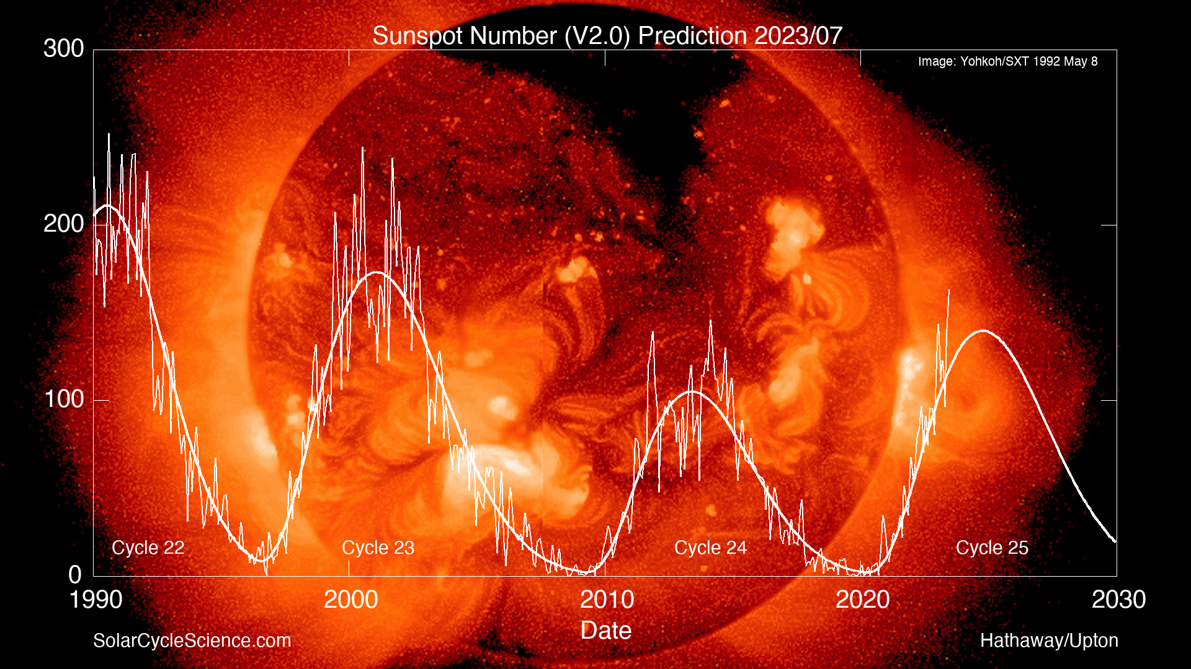
Measuring Solar Activity

Slide 85
Measuring Solar Activity
Solar-Flux Index (SFI) – a measure of 2800 MHz (10.7 cm wavelength) energy from the Sun
K index (0-9) – the short-term stability of the Earth's geomagnetic field
0 is quiet, 9 is extreme storm
A index (0-400) – long-term geomagnetic field stability around the world
Values 0 (stable) to 400 (greatly disturbed)
A is long-term, K is short-term

Slide 86
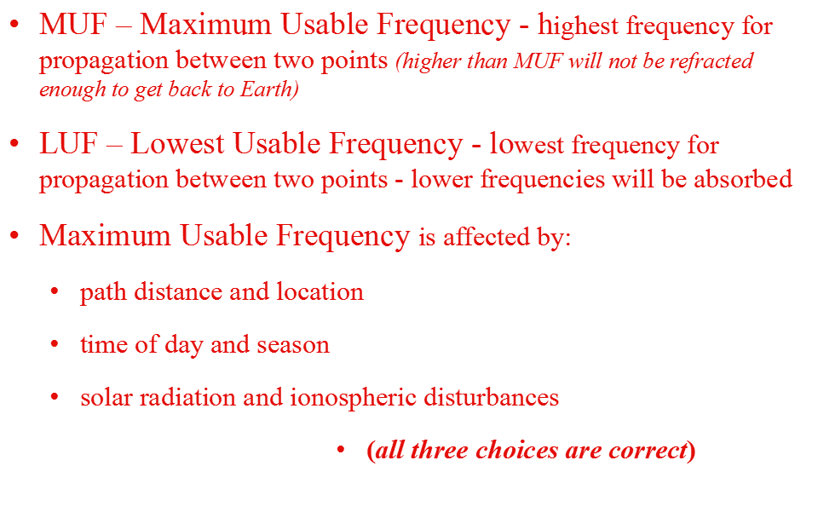
Assessing Propagation

Slide 87
Assessing Propagation
Signals with frequencies below the MUF and above the LUF are bent back to Earth from the ionosphere - Signals just below the MUF will have the least amount of attenuation
Signals with frequencies below the LUF are completely attenuated before reaching the intended destination. High levels of noise or static are typical on the lower HF frequencies in summer
Signals with frequencies above the MUF are not refracted enough to return to Earth: they proceed into space

Slide 88
Solar Disturbances
Solar flares emit UV & X-ray radiation that travels at the speed of light and reaches the Earth's ionosphere in about 8 minutes - it can cause a Sudden Ionospheric Disturbance (SID)
Increases D layer ionization and absorption dramatically, possibly causing a radio blackout that can last from seconds to several hours
Affects lower bands more than higher bands
SID only impacts the sunny side of the Earth so dark side may be relatively unaffected

Slide 89
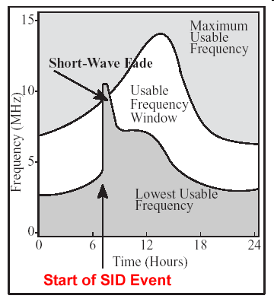
Assessing Propagation
If LUF rises above MUF, no ordinary sky-wave propagation is possible between those two points
Sudden Ionospheric Disturbance (SID)
Disrupts low frequencies more than higher frequencies

Slide 90
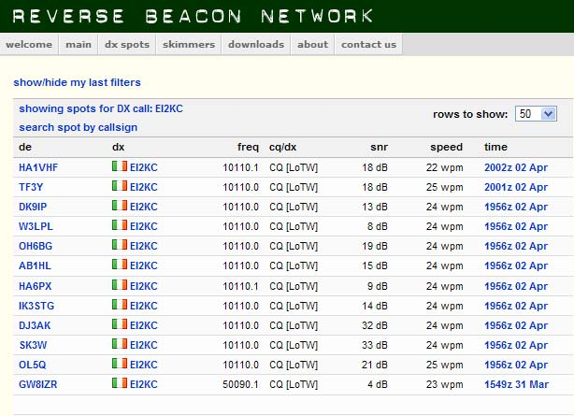
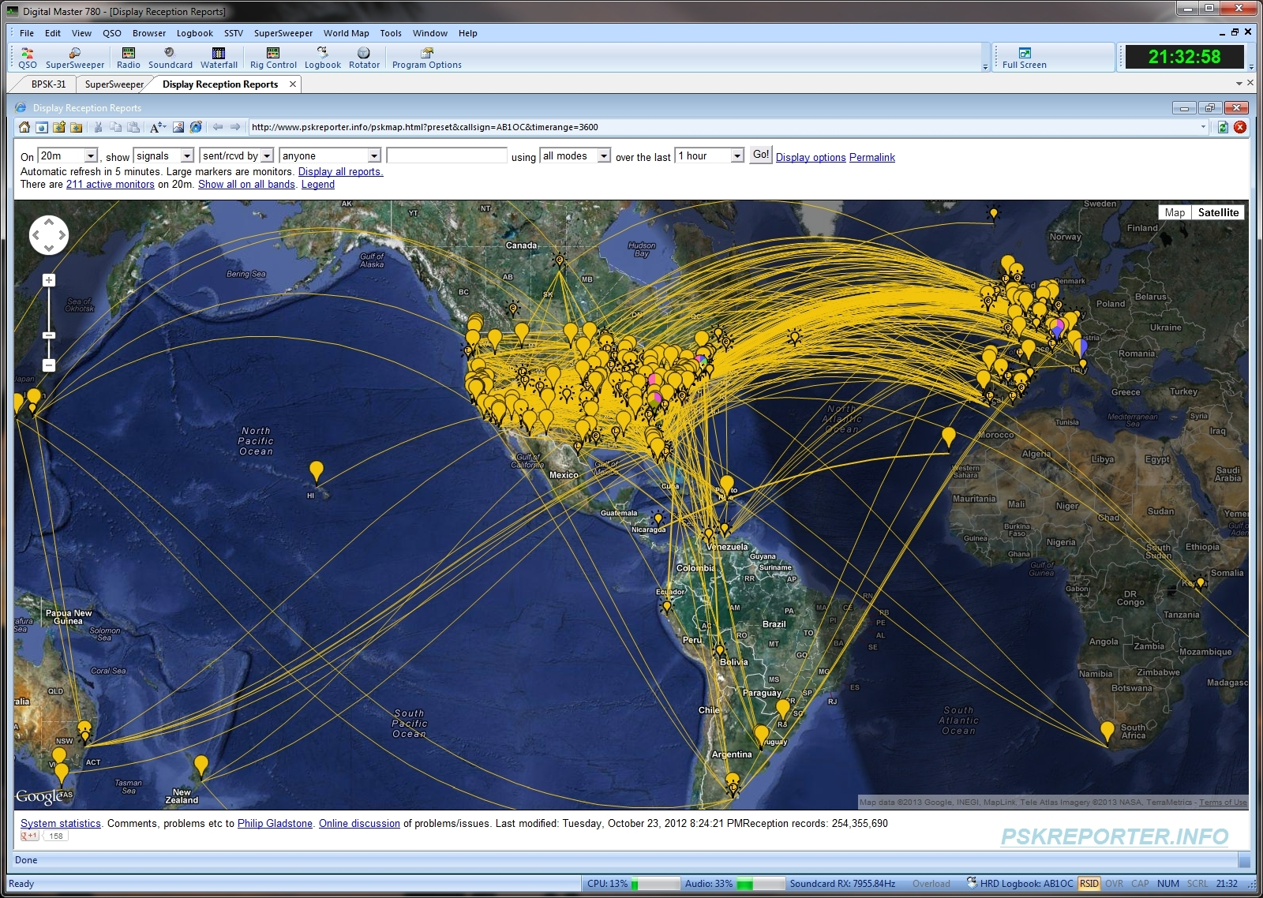
Assessing Propagation
Automated receiving stations linked to the internet can allow you to see where your transmissions are being received. (Reverse Beacon Network, PSK Reporter, etc.)

Slide 91
Solar Disturbances
Solar flare – a large eruption of energy and solar material on the surface of the Sun
Corona - The extended outer atmosphere of the Sun
Coronal hole – a weak area in the Sun’s outer layer where ionized gas and charged particles escape the Sun’s magnetic field
Coronal mass ejection (CME) – an ejection of large amounts of material from the corona
CME may be directed in a narrow stream or wide spray (usually disruptive to HF radio communications)

Slide 92
Solar Disturbances
Geomagnetic Disturbances
The Sun gives off a stream of particles called solar wind
These can cause a Geomagnetic Storm, a temporary disturbance in the Earth's geomagnetic field (next slide)
Charged particles from coronal holes and CMEs take from 15 hours to several days to reach the Earth
Particles increase ionization in the E region
Causes auroral displays and geomagnetic storms

Slide 93
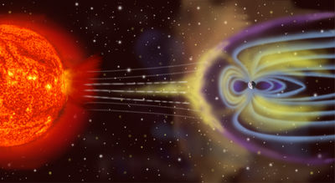
Solar Disturbances
Sudden changes in the geomagnetic field disrupts the upper ionosphere, causing long-distance paths at high latitudes near the magnetic poles to be wiped out for a period of hours to days
Auroras are actually gases ionized by the incoming charged particles as they flow vertically down into the atmosphere, guided by the intense magnetic field near the magnetic poles
Auroras can reflect VHF signals - Auroral propagation is strongest on 6 and 2 meters (signals will hiss or buzz)

Slide 94
C:\Users\ai2n\Videos\General Course - Videos\VE3EN_6m_SSB_AURORA_Short.wmv
VE3EN 6m SSB AURORA
(note the slow, deliberate, speech to enhance intelligibility)

Slide 95
Take Quiz 4

Slide 96
G3A01 - How does a higher sunspot number affect HF propagation?
A. Higher sunspot numbers generally indicate a greater probability of good propagation at higher frequencies
B. Lower sunspot numbers generally indicate greater probability of sporadic E propagation
C. A zero sunspot number indicates that radio propagation is not possible on any band
D. A zero sunspot number indicates undisturbed conditions

Slide 97
G3A01 - How does a higher sunspot number affect HF propagation?
A. Higher sunspot numbers generally indicate a greater probability of good propagation at higher frequencies
B. Lower sunspot numbers generally indicate greater probability of sporadic E propagation
C. A zero sunspot number indicates that radio propagation is not possible on any band
D. A zero sunspot number indicates undisturbed conditions

Slide 98
G3A04 - Which of the following are the least reliable bands for long-distance communications during periods of low solar activity?
A. 80 meters and 160 meters
B. 60 meters and 40 meters
C. 30 meters and 20 meters
D. 15 meters, 12 meters, and 10 meters

Slide 99
G3A04 - Which of the following are the least reliable bands for long-distance communications during periods of low solar activity?
A. 80 meters and 160 meters
B. 60 meters and 40 meters
C. 30 meters and 20 meters
D. 15 meters, 12 meters, and 10 meters

Slide 100
G3A05 - What is the solar flux index?
A. A measure of the highest frequency that is useful for ionospheric propagation between two points on Earth
B. A count of sunspots that is adjusted for solar emissions
C. Another name for the American sunspot number
D. A measure of solar radiation with a wavelength of 10.7 centimeters

Slide 101
G3A05 - What is the solar flux index?
A. A measure of the highest frequency that is useful for ionospheric propagation between two points on Earth
B. A count of sunspots that is adjusted for solar emissions
C. Another name for the American sunspot number
D. A measure of solar radiation with a wavelength of 10.7 centimeters

Slide 102
G3A07 - At what point in the solar cycle does the 20-meter band usually support worldwide propagation during daylight hours?
A. At the summer solstice
B. Only at the maximum point
C. Only at the minimum point
D. At any point

Slide 103
G3A07 - At what point in the solar cycle does the 20-meter band usually support worldwide propagation during daylight hours?
A. At the summer solstice
B. Only at the maximum point
C. Only at the minimum point
D. At any point

Slide 104
G3A10 - What causes HF propagation conditions to vary periodically in a 26- to 28-day cycle?
A. Long term oscillations in the upper atmosphere
B. Cyclic variation in Earth's radiation belts
C. Rotation of the Sun's surface layers around its axis
D. The position of the Moon in its orbit

Slide 105
G3A10 - What causes HF propagation conditions to vary periodically in a 26- to 28-day cycle?
A. Long term oscillations in the upper atmosphere
B. Cyclic variation in Earth's radiation belts
C. Rotation of the Sun's surface layers around its axis
D. The position of the Moon in its orbit

Slide 106
G3A12 - What does the K-index measure?
A. The relative position of sunspots on the surface of the Sun
B. The short-term stability of Earth's geomagnetic field
C. The short-term stability of the Sun's magnetic field
D. The solar radio flux at Boulder, Colorado

Slide 107
G3A12 - What does the K-index measure?
A. The relative position of sunspots on the surface of the Sun
B. The short-term stability of Earth's geomagnetic field
C. The short-term stability of the Sun's magnetic field
D. The solar radio flux at Boulder, Colorado

Slide 108
G3A13 - What does the A-index measure?
A. The relative position of sunspots on the surface of the Sun
B. The amount of polarization of the Sun's electric field
C. The long-term stability of Earth's geomagnetic field
D. The solar radio flux at Boulder, Colorado

Slide 109
G3A13 - What does the A-index measure?
A. The relative position of sunspots on the surface of the Sun
B. The amount of polarization of the Sun's electric field
C. The long-term stability of Earth's geomagnetic field
D. The solar radio flux at Boulder, Colorado

Slide 110
G3B12 - Which of the following is typical of the lower HF frequencies during the summer?
A. Poor propagation at any time of day
B. World-wide propagation during daylight hours
C. Heavy distortion on signals due to photon absorption
D. High levels of atmospheric noise or static

Slide 111
G3B12 - Which of the following is typical of the lower HF frequencies during the summer?
A. Poor propagation at any time of day
B. World-wide propagation during daylight hours
C. Heavy distortion on signals due to photon absorption
D. High levels of atmospheric noise or static

Slide 112
G3A02 - What effect does a sudden ionospheric disturbance have on the daytime ionospheric propagation?
A. It enhances propagation on all HF frequencies
B. It disrupts signals on lower frequencies more than those on higher frequencies
C. It disrupts communications via satellite more than direct communications
D. None, because only areas on the night side of the Earth are affected

Slide 113
G3A02 - What effect does a sudden ionospheric disturbance have on the daytime ionospheric propagation?
A. It enhances propagation on all HF frequencies
B. It disrupts signals on lower frequencies more than those on higher frequencies
C. It disrupts communications via satellite more than direct communications
D. None, because only areas on the night side of the Earth are affected

Slide 114
G3A03 - Approximately how long does it take the increased ultraviolet and X-ray radiation from a solar flare to affect radio propagation on Earth?
A. 28 days
B. 1 to 2 hours
C. 8 minutes
D. 20 to 40 hours

Slide 115
G3A03 - Approximately how long does it take the increased ultraviolet and X-ray radiation from a solar flare to affect radio propagation on Earth?
A. 28 days
B. 1 to 2 hours
C. 8 minutes
D. 20 to 40 hours

Slide 116
G3A06 - What is a geomagnetic storm?
A. A sudden drop in the solar flux index
B. A thunderstorm that affects radio propagation
C. Ripples in the geomagnetic force
D. A temporary disturbance in Earth's geomagnetic field

Slide 117
G3A06 - What is a geomagnetic storm?
A. A sudden drop in the solar flux index
B. A thunderstorm that affects radio propagation
C. Ripples in the geomagnetic force
D. A temporary disturbance in Earth's geomagnetic field

Slide 118
G3A08 - How can a geomagnetic storm affect HF propagation?
A. Improve high-latitude HF propagation
B. Degrade ground wave propagation
C. Improve ground wave propagation
D. Degrade high-latitude HF propagation

Slide 119
G3A08 - How can a geomagnetic storm affect HF propagation?
A. Improve high-latitude HF propagation
B. Degrade ground wave propagation
C. Improve ground wave propagation
D. Degrade high-latitude HF propagation

Slide 120
G3A09 - How can high geomagnetic activity benefit radio communications?
A. Creates auroras that can reflect VHF signals
B. Increases signal strength for HF signals passing through the polar regions
C. Improve HF long path propagation
D. Reduce long delayed echoes

Slide 121
G3A09 - How can high geomagnetic activity benefit radio communications?
A. Creates auroras that can reflect VHF signals
B. Increases signal strength for HF signals passing through the polar regions
C. Improve HF long path propagation
D. Reduce long delayed echoes

Slide 122
G3A11 - How long does it take a coronal mass ejection to affect radio propagation on Earth?
A. 28 days
B. 14 days
C. 4 to 8 minutes
D. 15 hours to several days

Slide 123
G3A11 - How long does it take a coronal mass ejection to affect radio propagation on Earth?
A. 28 days
B. 14 days
C. 4 to 8 minutes
D. 15 hours to several days

Slide 124
G3A14 - How is long distance radio communication usually affected by the charged particles that reach Earth from solar coronal holes?
A. HF communication is improved
B. HF communication is disturbed
C. VHF/UHF ducting is improved
D. VHF/UHF ducting is disturbed

Slide 125
G3A14 - How is long distance radio communication usually affected by the charged particles that reach Earth from solar coronal holes?
A. HF communication is improved
B. HF communication is disturbed
C. VHF/UHF ducting is improved
D. VHF/UHF ducting is disturbed

Slide 126
G3B02 - What factors affect the MUF?
A. Path distance and location
B. Time of day and season
C. Solar radiation and ionospheric disturbances
D. All these choices are correct

Slide 127
G3B02 - What factors affect the MUF?
A. Path distance and location
B. Time of day and season
C. Solar radiation and ionospheric disturbances
D. All these choices are correct

Slide 128
G3B03 - Which frequency will have the least attenuation for long-distance skip propagation?
A. Just below the MUF
B. Just above the LUF
C. Just below the critical frequency
D. Just above the critical frequency

Slide 129
G3B03 - Which frequency will have the least attenuation for long-distance skip propagation?
A. Just below the MUF
B. Just above the LUF
C. Just below the critical frequency
D. Just above the critical frequency

Slide 130
G3B04 - Which of the following is a way to determine current propagation on a desired band from your station?
A. Use a network of automated receiving stations on the internet to see where your transmissions are being received
B. Check the A-index
C. Send a series of dots and listen for echoes
D. All these choices are correct

Slide 131
G3B04 - Which of the following is a way to determine current propagation on a desired band from your station?
A. Use a network of automated receiving stations on the internet to see where your transmissions are being received
B. Check the A-index
C. Send a series of dots and listen for echoes
D. All these choices are correct

Slide 132
G3B05 - How does the ionosphere affect radio waves with frequencies below the MUF and above the LUF?
A. They are refracted back to Earth
B. They pass through the ionosphere
C. They are amplified by interaction with the ionosphere
D. They are refracted and trapped in the ionosphere to circle Earth

Slide 133
G3B05 - How does the ionosphere affect radio waves with frequencies below the MUF and above the LUF?
A. They are refracted back to Earth
B. They pass through the ionosphere
C. They are amplified by interaction with the ionosphere
D. They are refracted and trapped in the ionosphere to circle Earth

Slide 134
G3B06 - What usually happens to radio waves with frequencies below the LUF?
A. They are refracted back to Earth
B. They pass through the ionosphere
C. They are attenuated before reaching the destination
D. They are refracted and trapped in the ionosphere to circle Earth

Slide 135
G3B06 - What usually happens to radio waves with frequencies below the LUF?
A. They are refracted back to Earth
B. They pass through the ionosphere
C. They are attenuated before reaching the destination
D. They are refracted and trapped in the ionosphere to circle Earth

Slide 136
G3B07 - What does LUF stand for?
A. The Lowest Usable Frequency for communications between two specific points
B. Lowest Usable Frequency for communications to any point outside a 100-mile radius
C. The Lowest Usable Frequency during a 24-hour period
D. Lowest Usable Frequency during the past 60 minutes

Slide 137
G3B07 - What does LUF stand for?
A. The Lowest Usable Frequency for communications between two specific points
B. Lowest Usable Frequency for communications to any point outside a 100-mile radius
C. The Lowest Usable Frequency during a 24-hour period
D. Lowest Usable Frequency during the past 60 minutes

Slide 138
G3B08 - What does MUF stand for?
A. The Minimum Usable Frequency for communications between two points
B. The Maximum Usable Frequency for communications between two points
C. The Minimum Usable Frequency during a 24-hour period
D. The Maximum Usable Frequency during a 24-hour period

Slide 139
G3B08 - What does MUF stand for?
A. The Minimum Usable Frequency for communications between two points
B. The Maximum Usable Frequency for communications between two points
C. The Minimum Usable Frequency during a 24-hour period
D. The Maximum Usable Frequency during a 24-hour period

Slide 140
G3B11 What happens to HF propagation when the LUF exceeds the MUF?
A. Propagation via ordinary skywave communications is not possible over that path
B. HF communications over the path are enhanced
C. Double-hop propagation along the path is more common
D. Propagation over the path on all HF frequencies is enhanced

Slide 141
G3B11 What happens to HF propagation when the LUF exceeds the MUF?
A. Propagation via ordinary skywave communications is not possible over that path
B. HF communications over the path are enhanced
C. Double-hop propagation along the path is more common
D. Propagation over the path on all HF frequencies is enhanced

Slide 142
General License Course Chapter 8.3
Scatter Modes

Slide 143
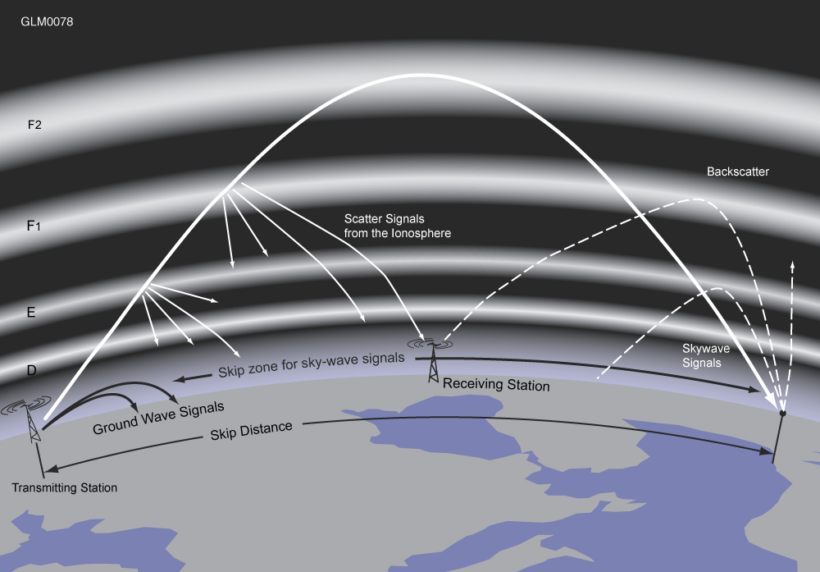
Ionospheric Reflections
Scatter

Slide 144
Scatter Modes
Scatter Characteristics
HF scatter signals in the skip zone are usually weak because only a small part of the signal energy is scattered into the skip zone
Signals typically have a fluttering or wavering sound
HF Scatter signals often sound distorted because their signal energy is scattered into the skip zone through several different radio wave paths
An indication that a signal heard is being received via scatter propagation is that the signal is heard on a frequency above the Maximum Usable Frequency for that path, in what would usually be considered the skip zone

Slide 145
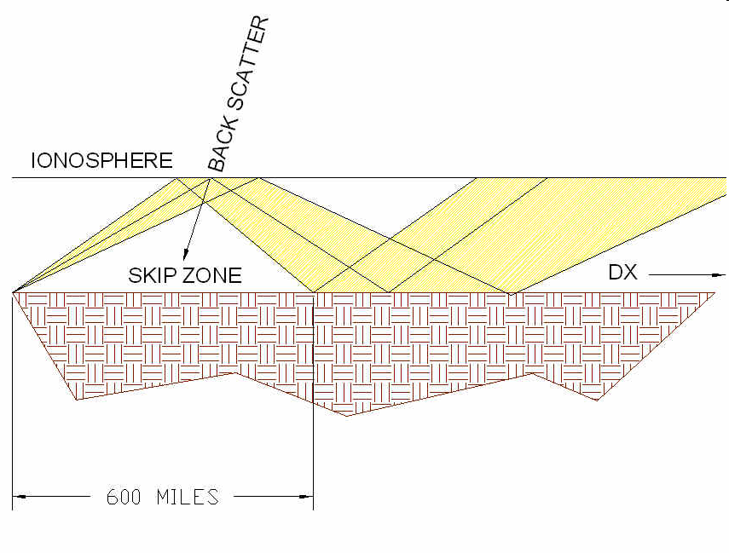
Scatter Modes
Scatter Characteristics
Signals can be heard from stations that are too far away to be received via ground wave but too near for normal sky-wave propagation (above MUF)
Back scatter reflects signals back toward the transmitter. Back scatter helps fill in the skip zone where signals would otherwise not be heard

Slide 146
Scatter Modes
C:\Users\ai2n\Videos\General Course - Videos\backscatter - w1aw-8 in oh.wmv
W1AW/8 in Ohio - 15m CW

Slide 147
Scatter Modes - NVIS
NVIS = Near Vertical Incidence Sky-wave, which enables short distance MF or HF propagation using high elevation angles.
Reflections from a signal radiating vertically are returned to Earth over a 200-300 mile range around the transmitting station
Horizontal dipoles placed close to the ground (⅛ to ¼ wavelength high) have an omnidirectional pattern at very high angles - good for regional daytime communications on 160-40 meters
NVIS works best at 40 meters and lower-frequency bands

Slide 148
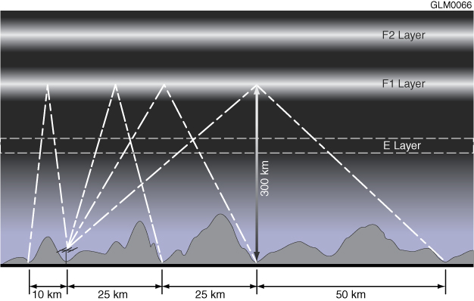
NVIS Reflections

Slide 149
Take Quiz 5

Slide 150
G3C06 - What is a characteristic of HF scatter?
A. Phone signals have high intelligibility
B. Signals have a fluttering sound
C. There are very large, sudden swings in signal strength
D. Scatter propagation occurs only at night

Slide 151
G3C06 - What is a characteristic of HF scatter?
A. Phone signals have high intelligibility
B. Signals have a fluttering sound
C. There are very large, sudden swings in signal strength
D. Scatter propagation occurs only at night

Slide 152
G3C07 - What makes HF scatter signals often sound distorted?
A. The ionospheric region involved is unstable
B. Ground waves are absorbing much of the signal
C. The E region is not present
D. Energy is scattered into the skip zone through several different paths

Slide 153
G3C07 - What makes HF scatter signals often sound distorted?
A. The ionospheric region involved is unstable
B. Ground waves are absorbing much of the signal
C. The E region is not present
D. Energy is scattered into the skip zone through several different paths

Slide 154
G3C08 - Why are HF scatter signals in the skip zone usually weak?
A. Only a small part of the signal energy is scattered into the skip zone
B. Signals are scattered from the magnetosphere, which is not a good reflector
C. Propagation is via ground waves, which absorb most of the signal energy
D. Propagation is via ducts in the F region, which absorb most of the energy

Slide 155
G3C08 - Why are HF scatter signals in the skip zone usually weak?
A. Only a small part of the signal energy is scattered into the skip zone
B. Signals are scattered from the magnetosphere, which is not a good reflector
C. Propagation is via ground waves, which absorb most of the signal energy
D. Propagation is via ducts in the F region, which absorb most of the energy

Slide 156
G3C09 - What type of propagation allows signals to be heard in the transmitting station's skip zone?
A. Faraday rotation
B. Scatter
C. Chordal hop
D. Short-path

Slide 157
G3C09 - What type of propagation allows signals to be heard in the transmitting station's skip zone?
A. Faraday rotation
B. Scatter
C. Chordal hop
D. Short-path

Slide 158
G3C10 - What is near vertical incidence skywave (NVIS) propagation?
A. Propagation near the MUF
B. Short distance MF or HF propagation at high elevation angles
C. Long path HF propagation at sunrise and sunset
D. Double hop propagation near the LUF

Slide 159
G3C10 - What is near vertical incidence skywave (NVIS) propagation?
A. Propagation near the MUF
B. Short distance MF or HF propagation at high elevation angles
C. Long path HF propagation at sunrise and sunset
D. Double hop propagation near the LUF

Slide 160
Next Week
Chapters 4.5-4.7

